Slide 1
Software Architecture

Slide 2

Software Architecture : Architecturally Significant Requirements (ASR)

Slide 3
Agenda
Architecturally Significant Requirements (ASR)
Identifying ASR from Requirement Documents
Interviewing Stakeholders (QAW – Quality Attributes Workshop)
Identifying Business Goals (PALM – Pedigreed Attribute eLicitation Method)
Building Utility Tree
What will be the best way forward?

Slide 4
Architecturally Significant Requirements (ASR)
An architecturally significant requirement (ASR) is a requirement that will have a profound effect on the architecture of a system
Architecturally significant requirements are those requirements that have a measurable effect on a computer system’s architecture.
This can comprise both software and hardware requirements. They are a subset of requirements, the subset that affects the architecture of a system in measurably identifiable ways.
Architecture might well be dramatically different in the absence of such a requirement.
ASRs play a key role in determining the overall structure of a software system and influence design decisions early in the development process
Important to categorize requirements into Critical, Important and Useful
Even in critical applications only 40 % of software features are used.

Slide 5
Architecturally Significant Requirements (ASR)
Indicators for architectural significance include
The requirement holds significant business value and/or presents a technical risk.
The requirement is important to a key stakeholder with considerable influence.
The requirement is unique, meaning that no existing components within the architecture address it.
The requirement has quality of service (QoS) or service level agreement (SLA) aspects that differ from those currently accommodated by the evolving architecture.
The requirement has previously led to budget overruns or client dissatisfaction in a project with a similar context.
Common example of ASRs are
Scalability: System should support future growth with minimal effort.
Security: System must protect data and prevent unauthorized access.
Availability: System should have a specific uptime or reliability rate.

Slide 6
Architecturally Significant Requirements (ASR) –Drivers
Drivers are the key factors that influence the identification and prioritization of these requirements
Business Goals and Constraints ( high uptime, horizontal scaling)
Stakeholder Concerns (prioritize one requirement over other – security over performance )
Quality Attributes ( Performance, availability, usability etc.)
Regulatory and Compliance Requirements (Ex: GDPR, HIPAA)
Technology Constraints and Opportunities ( development framework, deployment environment , database etc.)
Cost and Budget Constraints
Time to Market

Slide 7
Challenging requirements
Simple functional requirements like ‘System should be able to create an order’, ‘System should keep track of inventory’, etc. are straight forward to implement
Some functional requirements such as ‘We should be able to detect fraud in real time and block the user’ may not be that straight forward
Some non-functional requirements like the ‘System should be easy to customize for a different organization” may not be straight forward to implement
Systems must remain operational even under heavy loads or in case of hardware failure.
Handling millions of simultaneous user requests without service degradation (e.g., streaming platforms like Netflix or YouTube).
A healthcare application storing and transmitting electronic health records (EHRs) must be HIPAA compliant and immune to security breaches.
Such challenging requirements are called ‘Architecturally Significant Requirements’ (ASR)

Slide 8
Examples of ASRs
Audit trail
Alert & Notifications
Variety of data input mechanisms
Third party interaction
Workflow
User behaviour analysis (ex. in e-commerce)
A user-friendly and responsive web or mobile application
Business to maintain their own rules to facilitate decision making.
All such requirements need to be probed in detail, and we need to understand the specific scenarios in order to decide the design approach

Slide 9
Deeper understanding of requirements helps identify ASRs
Audit trail: Should we use File or DB? This will depend on how the audit trail is going to be used – are we going to perform some kind of analysis of the activities or are we looking for a specific activity
Third party interaction: We need to understand what communication mechanisms are supported by the 3rd party.
Notifications: Should it be an SMS notification or eMail notification or notifying an application via message queue? Should it be a one way notification or do we need an Acknowledgement?

Slide 10
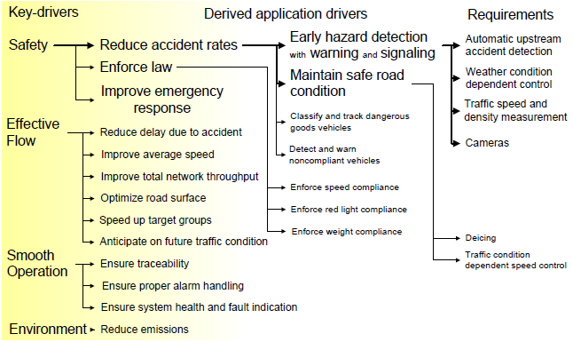
Ex. of probing the requirements - ‘Traffic Management System’

Slide 11
Different ways to identify ASRs
The requirements documents or user stories are an obvious starting point for identifying potential ASR candidates. However, there are additional methods for discovering ASRs
Requirements
Design Decisions
Business goals
Stakeholder
Utility Tree

Slide 12
ASR from Requirement Documents
Do requirements specification follow the principle of “MoSCoW” style (must, should, could, won’t), or as a collection of “user stories ”?
Do the requirement capturing exercise include Quality Attributes as well in equal proportions as per Software Engineering Body of Knowledge (SWEBOK) recommendations?
Have you come across BSR (Basic Skill Requirements) with explicit requirements on “ high usability”, “System Modularity”, “performance through Resilience”, “Fault detection” etc.,?
So, in the absence of BSR not reflecting the QA clearly, it is a challenge for an ARCHITECT to extract ASR . However, that makes the Role of an Architect requisite.

Slide 13
Look for leads from Design Decision
Design Decision Category | Look for Requirements addressing
Allocation of Responsibilities | Planned evolution of responsibilities, user roles, system modes, major processing steps, commercial packages
Coordination Model | Properties of the coordination (timeliness, currency, completeness, correctness, and consistency) Names of external elements, protocols, sensors or actuators (devices), middleware, network configurations (including their security properties) Evolution requirements on the list above
Data Model | Processing steps, information flows, major domain entities, access rights, persistence, evolution requirements
Management of Resources | Time, concurrency, memory footprint, scheduling, multiple users, multiple activities, devices, energy usage, soft resources (buffers, queues, etc.) Scalability requirements on the list above
Mapping among Architectural Elements | Plans for teaming, processors, families of processors, evolution of processors, network configurations.
Binding Time Decisions | Extension of or flexibility of functionality, regional distinctions, language distinctions, portability, calibrations, configurations
Choice of Technology | Named technologies, changes to technologies (planned and unplanned)

Slide 14
ASR from interviewing Stakeholders
Quality Attributes Workshop (QAW) - Expectation : List of architectural Drivers
QAW Steps
1. Presentation & Introduction
2. Business Mission Presentation
3. Architectural Plan Presentation
4. Identification of Architectural Drivers
5.Scenario Brainstorming
6. Scenario Consolidation
7. Scenario Prioritization
Presentation & Introduction : Everyone introduces themselves, briefly stating their background, their role in the organization, and their relationship to the system being built.
Business Mission Presentation : The stakeholder representing the business concerns behind the system (typically a manager or management representative) spends about one hour presenting the system’s business context, broad functional requirements, constraints, and known quality attribute requirements. The quality attributes that will be refined in later steps

Slide 15
ASR from interviewing Stakeholders
Quality Attributes Workshop (QAW) - Expectation : List of architectural Drivers
Architectural Plan Presentation : At this point in the workshop, the architect will present the system architectural plans as they stand. This lets stakeholders know the current architectural thinking, to the extent that it exists.
Identification of Architectural Drivers : The facilitators will share their list of key architectural drivers that they assembled during steps 2 and 3, and ask the stakeholders for clarifications, additions, deletions, and corrections. The idea is to reach a consensus on a distilled list of architectural drivers that includes overall requirements, business drivers, constraints, and quality attributes.
Scenario Brainstorming : Each stakeholder expresses a scenario representing his or her concerns with respect to the system. Facilitators ensure that each scenario has an explicit stimulus and response. The facilitators ensure that at least one representative scenario exists for each architectural driver listed in step 4.
Scenario Consolidation : Similar scenarios are consolidated where reasonable. Facilitators ask stakeholders to identify those scenarios that are very similar in content. Scenarios that are similar are merged, as long as the people who proposed them agree and feel that their scenarios will not be diluted in the process
Scenario Prioritization : Prioritization of the scenarios is accomplished by allocating each stakeholder a number of votes equal to 30 percent of the total number of scenarios generated after consolidation

Slide 16
ASR from Business GOALS
Format : “X” to “Y” by when? : “X “ - Current State : “Y” - Future state
Business Goals Quality Attributes
Architecture
Non-architectural Solutions
Business goals often lead to quality attribute requirements
Business goals may directly affect the architecture without precipitating a quality attribute requirement at all
No influence at all

Slide 17
ASR from Business GOALS
Format : “X” to “Y” by when? : “X “ - Current State : “Y” - Future state
# | Category | Example
1 | Contributing to the growth and continuity of the organization | Market share by 15%
2 | Meeting financial objectives | 30 % Profit after tax
3 | Meeting personal objectives | Learn New Technologies
4 | Meeting responsibility to employees | Reduce work load by 8 %
5 | Meeting responsibility to society | Green Computing – Less CO2
6 | Meeting responsibility to state | Regulatory Compliance
7 | Meeting responsibility to shareholders | 1:3 Share Dividend
8 | Managing market position | IPR - 50 Design Registrations
9 | Improving business processes | Productivity Improvement
10 | Managing the quality and reputation of products | Automated Testing Strategy
11 | Managing change in environmental factors | US Dollar Volatility

Slide 18
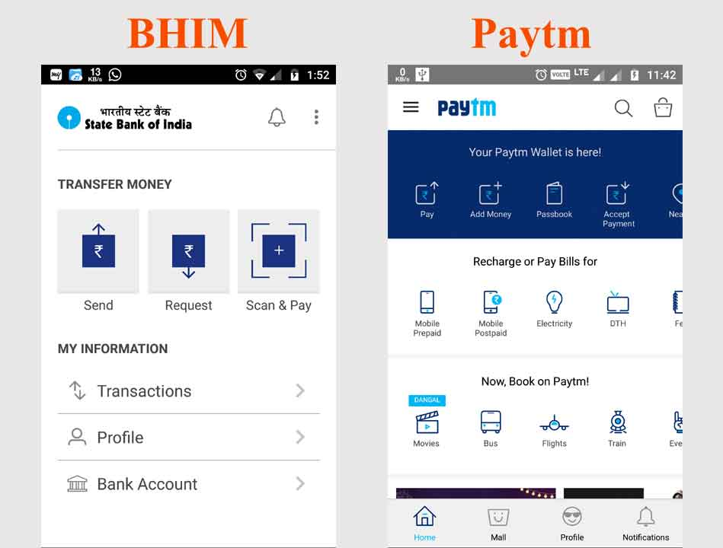

Example of Business Goal: BHIM
Examples of business goals:
Govt. wanted to speed-up cashless transactions
So Government introduced BHIM app
This translates into QAs:
Usability (easy steps)
Security (3-factors)

Slide 19
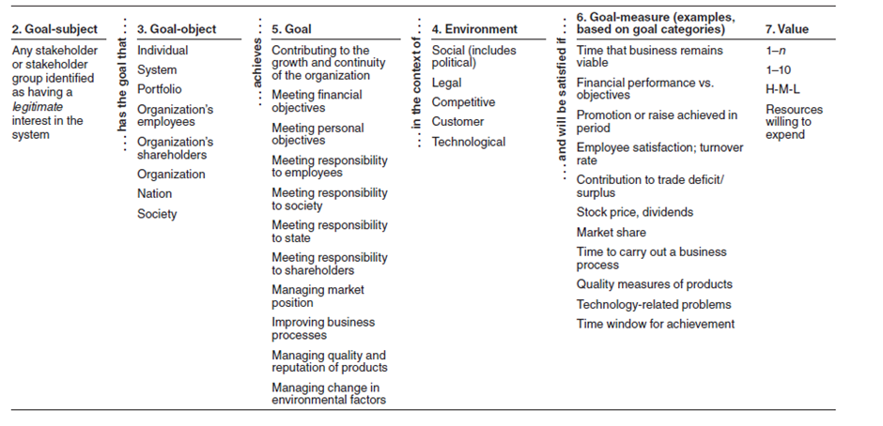
Format for Presenting Final Business Goals

Slide 20
PALM : Pedigreed Attribute eLicitation Method Capturing Business Goal
“Pedigree” means that the business Goal has a strong background:
PALM overview presentation. Overview of PALM, the problem it solves, its steps, and its expected outcomes.
Business driver’s presentation. Briefing of business drivers by project management. What are the goals of the customer organization for this system? What are the goals of the development organization?
Architecture driver’s presentation. Briefing by the architect on the driving business and quality attribute requirements: the ASRs.
Business goals elicitation. Using the standard business goal categories to guide discussion, capture the set of important business goals as scenarios, consolidate and prioritize them to identify important Goals.
Identification of potential quality attributes from business goals. For each important business goal scenario, participants describe a quality attribute that would help achieve it
Assignment of pedigree to existing quality attributes drivers. For each architectural driver named in step 3, we identify which business goals it is there to support. For example: Why is there a 40-millisecond performance requirement? Why not 60 milliseconds? Or 80 milliseconds?
Exercise conclusion. Review of results, next steps, and participant feedback

Slide 21
ASR in Utility Tree
An Architecturally Significant Requirement (ASR) in the context of a Utility Tree refers to a critical quality attribute that directly influences the system's architecture.
The Utility Tree is a hierarchical representation used in software architecture to capture and prioritize key quality attributes, breaking them down into more detailed scenarios.
The Utility Tree helps architects and stakeholders systematically explore and refine ASRs.
ASRs Fit into the Utility Tree
Root (Utility) -represents the system's overall utility, which is a measure of how well the system satisfies its stakeholders' needs
Branches (Quality Attributes)-represent key quality attributes such as performance, security, scalability, availability, and more
Leaf Nodes (Quality Scenarios) -Each quality attribute breaks down into more specific scenarios, detailing how the system should behave under certain conditions.

Slide 22
ASR in Utility Tree
Quality Attribute | Attribute Refinement | ASR
Performance | Transaction response time | A user updates a patient’s account in response to a change-of-address notification while the system is under peak load, and the transaction completes in less than 0.75 second. (H,M)
 |  | A user updates a patient’s account in response to a change-of-address notification while the system is under double the peak load, and the transaction completes in less than 4 seconds. (L,M)
 | Throughput | At peak load, the system is able to complete 150 normalized transactions per second. (M,M)
Usability | Proficiency training | A new hire with two or more years’ experience in the business becomes proficient in Nightingale’s core functions in less than 1 week. (M,L)
 |  | A user in a particular context asks for help, and the system provides help for that context, within 3 seconds. (H,M)
 | Normal operations | A hospital payment officer initiates a payment plan for a patient while interacting with that patient and completes the process without the system introducing delays. (M,M)

Slide 23
ASR in Utility Tree
Quality Attribute | Attribute Refinement | ASR
Configurability | User-defined changes | A hospital increases the fee for a particular service. The configuration team makes the change in 1 working day; no source code needs to change. (H,L)
Maintainability | Routine changes | A maintainer encounters search- and response-time deficiencies, fixes the bug, and distributes the bug fix with no more than 3 person-days of effort. (H,M)
 |  | A reporting requirement requires a change to the report generating metadata. Change is made in 4 person-hours of effort. (M,L)
 | Upgrades to commercial components | The database vendor releases a new version that must be installed in less than 3 person-weeks. (H,M)
Extensibility | Adding new product | A product that tracks blood bank donors is created within 2 person-months. (M,M)

Slide 24
ASR in Utility Tree
Quality Attribute | Attribute Refinement | ASR
Security | Confidentiality | A physical therapist is allowed to see that part of a patient’s record dealing with orthopaedic treatment but not other parts nor any financial information. (H,M)
 | Integrity | The system resists unauthorized intrusion and reports the intrusion attempt to authorities within 90 seconds. (H,M)
Availability | No Downtime | The database vendor releases new software, which is hot-swapped into place, with no downtime. (H,L)
 |  | The system supports 24/7 web-based account access by patients. (L,L)
H - High Priority | M - Moderate Priority | L - Low Priority

Slide 25

What is the Best Approach?
…. How much is the time scheduled in your project for this activity?
….. As an architect, even when no BSR, you are accountable for ASR…
…. Interview with stakeholders must be planned by you well in advance…..
…. Utility Tree is more like a repository approach…..
… Choose the one the most suits with the time to fill

Slide 26
Architecture in Agile Projects

Slide 27
Agile Vs. Traditional
Agile Development | Traditional Development
Individuals and interactions | Processes and tools
Working software | Comprehensive documentation
Customer collaboration | Contract negotiation
Responding to change | Following a plan

Slide 28
Agile Manifesto :12 Principles
# | Principles | # | Principles
1 | Early and continuous delivery of valuable software | 7 | Working software is the primary measure of progress
2 | Welcome changing requirements, even late in development | 8 | Agile processes promote sustainable development
3 | Deliver working software frequently, from a couple of weeks to a couple of months | 9 | Continuous attention to technical excellence and good design enhances agility.
4 | Business people and developers must work together | 10 | Simplicity is essential
5 | Build projects around motivated individuals | 11 | The best architectures, requirements, and designs emerge from self-organizing teams
6 | Face-to-Face conversation | 12 | At regular intervals, the team reflects on how to become more effective, then tunes and adjusts its behaviour accordingly

Slide 29
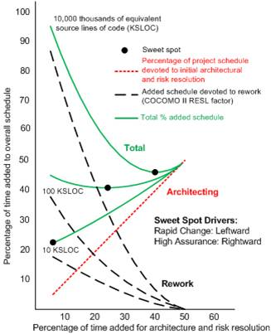
Analytics : Up-front Work Vs. Agility
Interpretations:
There is one line representing each of these three projects, starting near the Y axis and descending, at different rates, to the X axis at the 50 mark. This shows that adding time for up-front work reduces later rework.
when you sum each of those downward-trending lines (for the 10, 100, and 1,000 KSLOC projects) with the upward sloping line for the up-front (initial architecture and risk resolution) work, you get the second set of three lines, which start at the Y axis and meet the upward sloping line at the 50 mark on the X axis.
These lines show that there is a sweet spot for each project. For the 10 KSLOC project, the sweet spot is at the far left. This says that devoting much, if any, time to up-front work is a waste for a small project.
For the 100 KSLOC project, the sweet spot is at around 20 percent of the project schedule. And for the 1,000 KSLOC project, the sweet spot is at around 40 percent of the project schedule.
A project with a million lines of code is enormously complex, and it is difficult to imagine how Agile principles alone can cope with this complexity if there is no architecture to guide and organize the effort.

Slide 30
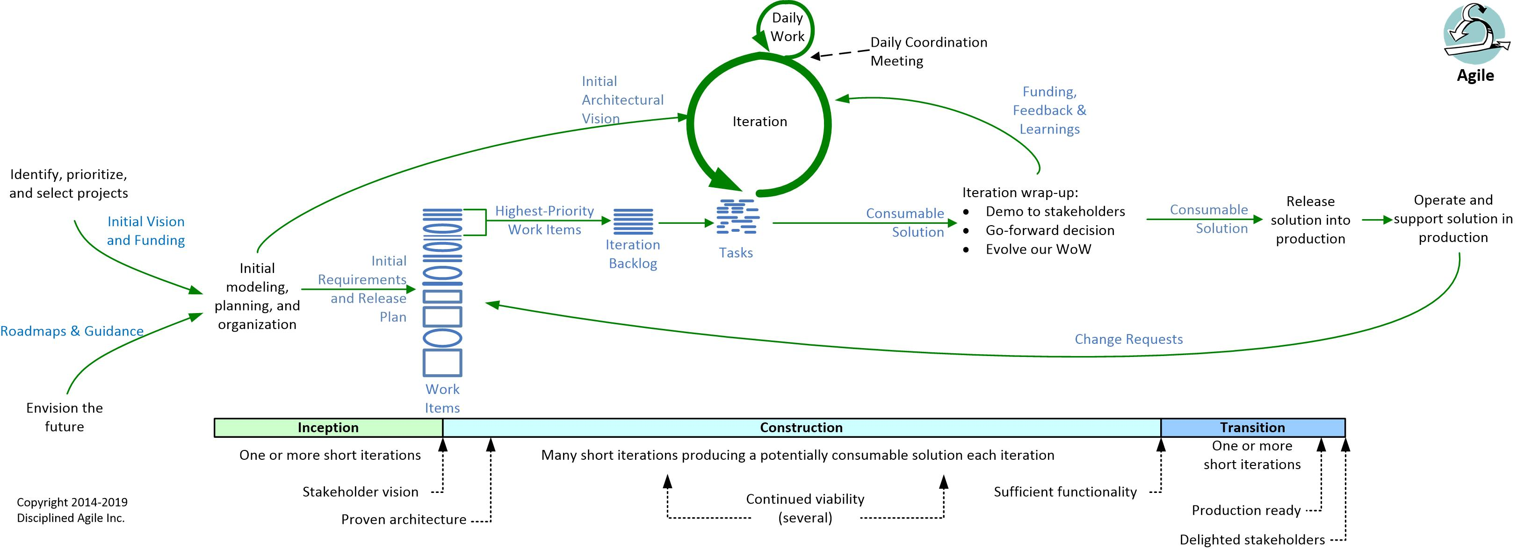
BDUF (Big Design Up-front Model) for Agile
Define Architecture completely Before Implementation

Slide 31
Thank you!
Sat Arch Episode Ep - 23: Architecturally Significant Requirements Part 1 (youtube.com)
Assignment work – [10 marks]-
How To Write A Case Study? | Amazon Case Study Example (youtube.com)

